Slide 1
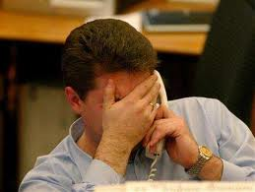
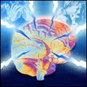
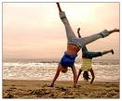
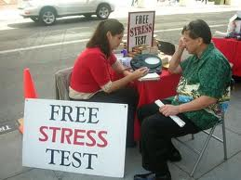
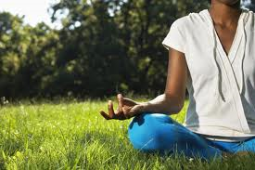
Scaling Personal Stress Assistance in the Natural Environment
Santosh Kumar, University of Memphis

Slide 2
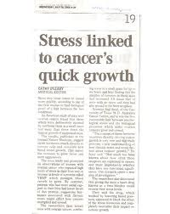
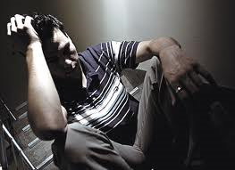
Stress – A Quietly Growing Epidemic
Stress leads to or worsens diseases of slow accumulation
Heart diseases
Cancer
Depression
Yet, continues to be widespread and growing
An urgency to help individuals reduce stress

Slide 3
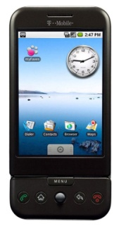
Personal Stress Assistance
An app on the mobile phone that can help us make choices in daily life that reduce stress
Suggesting routes for commuting
Suggesting adaptations to driving habits
Recommending restaurants to eat, etc.
Encourage conscious stress management activities, e.g.,
Meditation, yoga, exercise, light reading, etc.
Effective entertainment sources, relaxing conversations, etc.
And, suggest ways to help reduce stress of others we interact with (e.g., subordinates, customer service rep)
By showing the impact our actions (e.g., conversations, driving habits, etc.) have on the stress level of others

Slide 4
How to Scale Stress Assessment?
First step is to measure stress in the natural environment
Could use newly developed unobtrusively wearable sensors¹
And, software on the mobile phone² that uses sensor measurements to infer stress and its mediators
But, this requires every person to wear sensors in their natural environment on a daily basis
AutoSense: http://autosense.memphis.edu
FieldStream: http://www.fieldstream.org ; K. Plarre, et. al., IPSN 2011

Slide 5
Proposed Approach
Obtain a mapping between various daily activities and their impact on the stress level
For example, a user study could be conducted to determine the impact various traffic events have on the stress level (e.g., stop-go, traffic lights, left turns, potholes, etc.)
Then, the stress level of a road segment can be obtained from the frequency of stressful events that occur in them
Frequency of events could come from volunteer contributors who travel in that segment and later personalized to the owner
Similarly, stress mapping of driving actions (e.g., lane changes, braking patterns, phone calls, etc.) can be obtained
And, used to suggest changes in driving habits to reduce stress
Vision: A pervasive personal stress assistant

