Slide 1
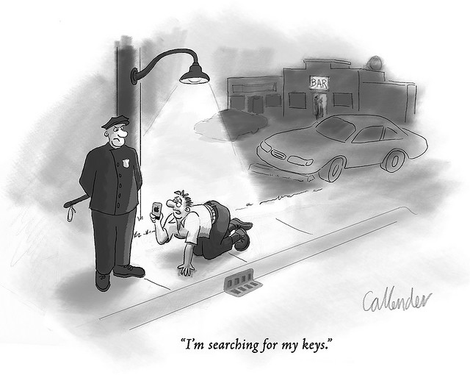
Beyond the Lamplight - Lessons from Making Sensor Networks Real
David E. Culler
University of California, Berkeley

Slide 2
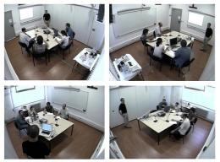
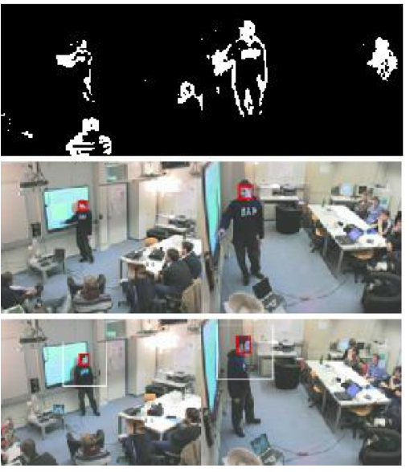
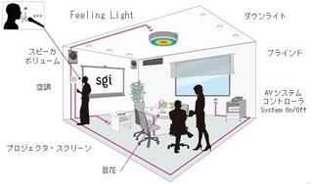
From “it worked, once”, to …

Slide 3
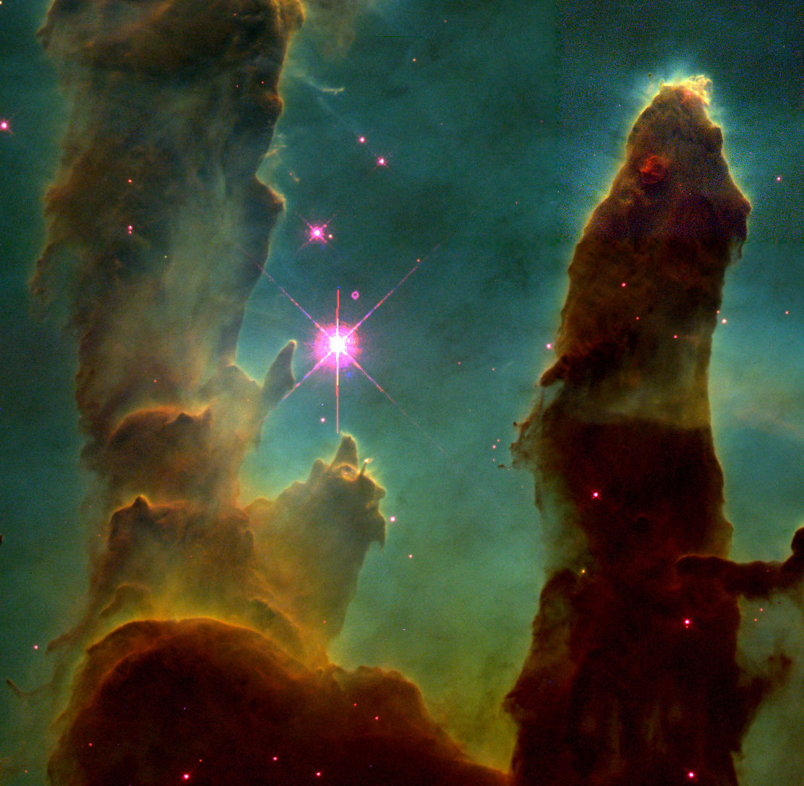
Mother Nature – Experiment Designer Extraordinaire

Slide 4

Nail it Before You Scale it

Slide 5
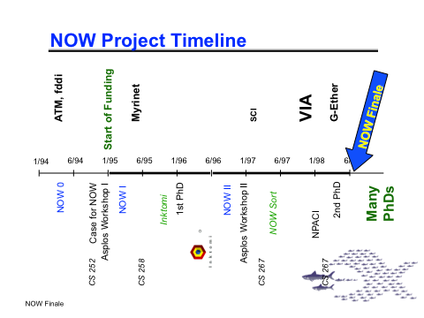
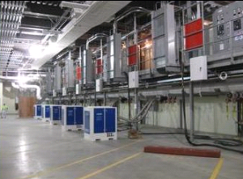
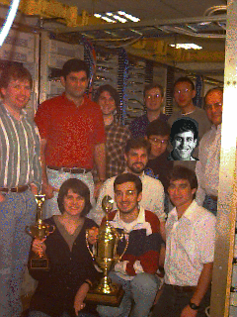
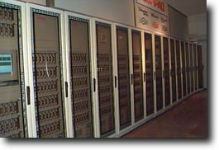
A Tale from times past

Slide 6



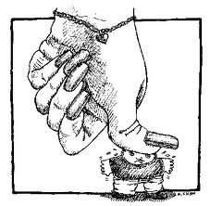


Slide 7





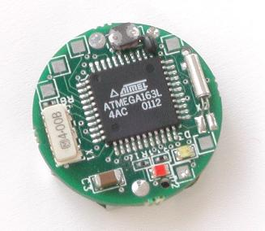
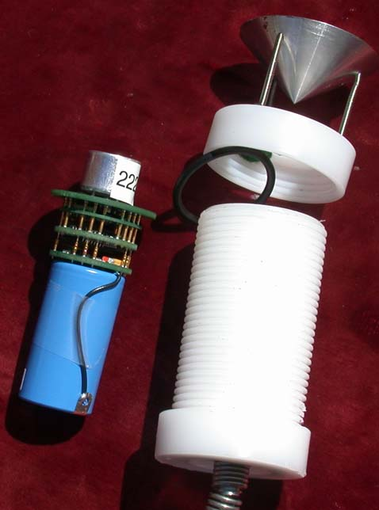
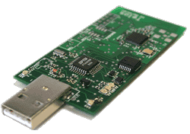
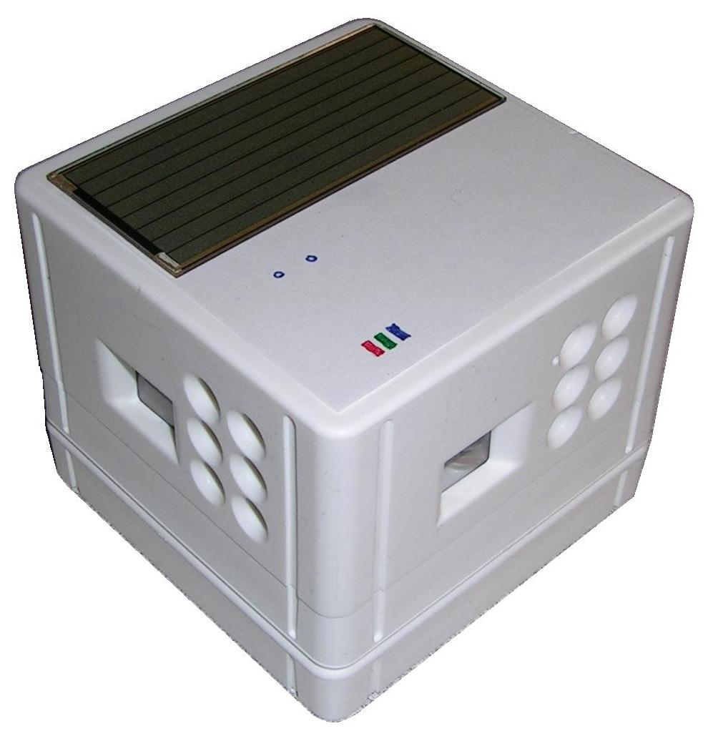

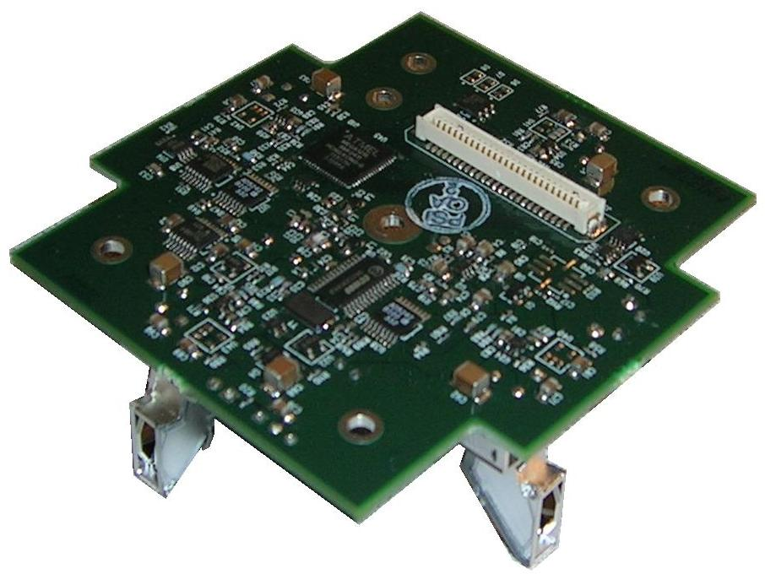
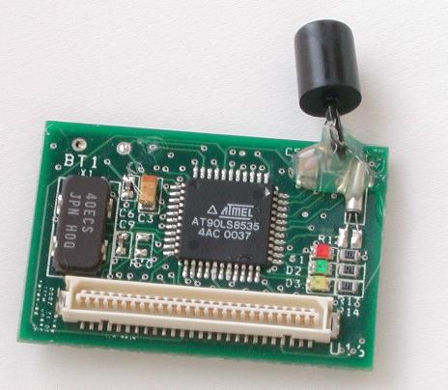
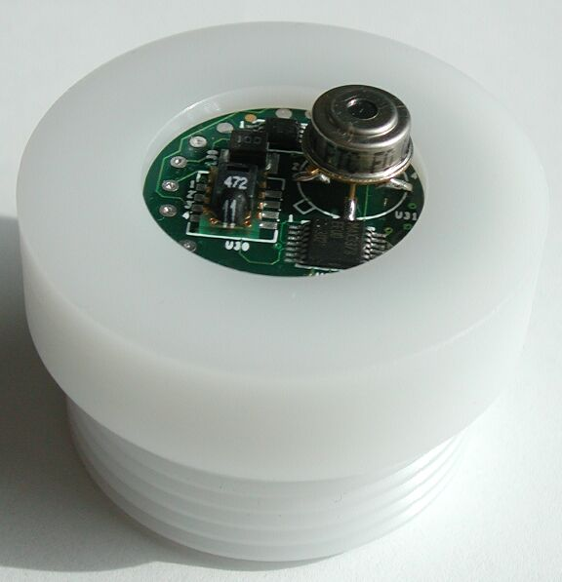
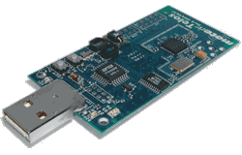
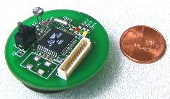
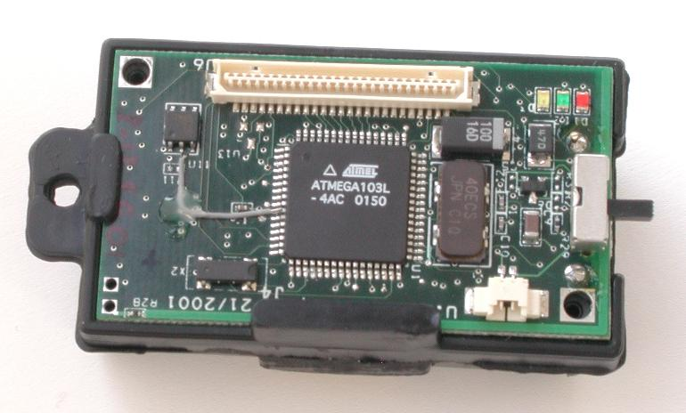
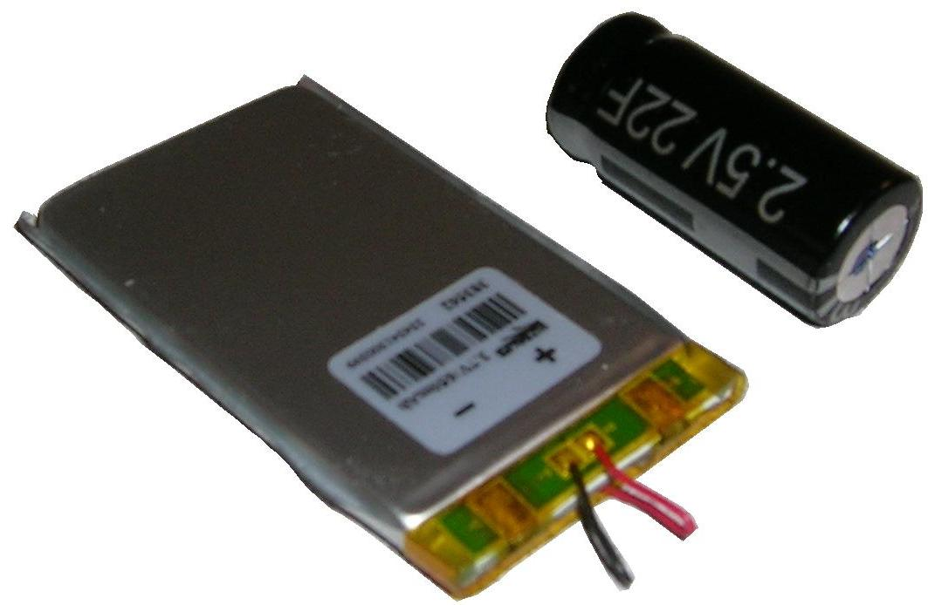
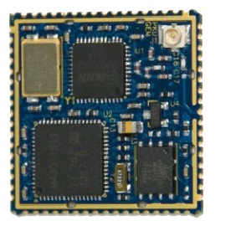
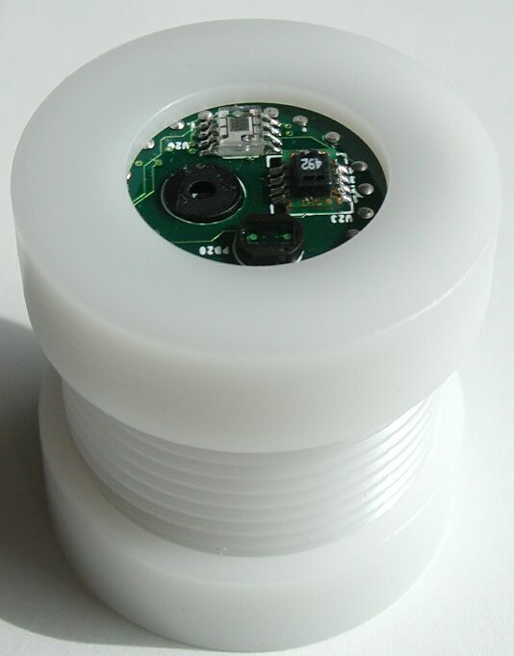














The Mote/TinyOS revolution…
zeevo BT
Intel
iMOTE
Intel
MOTE2
Intel
rene’
Intel/UCB
dot
BTNode
Intel
cf-mica
Eyes
trio
SmartDust
WeC
LoWPAN/IPv6
Rene
Mica
Telos
Epic
XBOW
rene2
XBOW
mica
XBOW
cc-dot
XBOW
mica2
XBOW
micaZ
digital sun
rain-mica
Bosch
cc-mica
Dust Inc
blue cc-TI
98
99
00
01
02
03
04
05
06
07
SENSIT
Expedition
8 kB rom
½ kB ram
NEST
NSF
CENS STC
48 kB rom
10 kB ram
802.15.4
NETS/ NOSS
Cyber-Physical

Slide 8
Leading Internet Research Perspective - a decade ago
“Resource constraints may cause us to give up the layered architecture.”
“Sheer numbers of devices, and their unattended deployment, will preclude reliance on broadcast communication or the configuration currently needed to deploy and operate networked devices.”
“There are significant robustness and scalability advantages to designing applications using localized algorithms.”
“Unlike traditional networks, a sensor node may not need an identity (e.g. address).”
“It is reasonable to assume that sensor networks can be tailored to the application at hand.”
We were wrong...

Slide 9
Complete Embedded IPv6 Stack
App
HTTP
Telnet
SNMP
DNS
…
DHCPv6
Tran
UDP
TCP
Net
Forwarder
Router
ICMPv6
Autoconf
Multicast
Unicast
Routing Protocol
Buffer
Queue
Send Manager
Forwarding Table
Prefix | Next
Default
Routing Table
Send Manager
Prefix | Next
Stateless
Autoconf
6LoWPAN Adaptation
Link
Data
Ack
Media Management Control
Remote Media
Link Stats
Local Media
Neighbor Table
Addr | Period | Phase | Pending | RSSI | PRR
Sample Period
Sample Phase

Slide 10
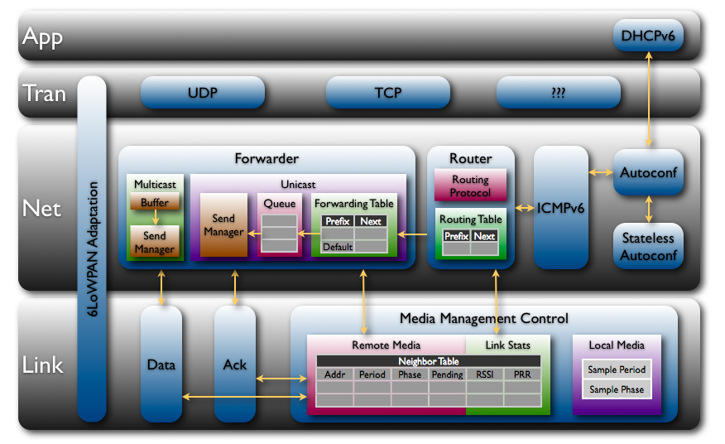
At “scale” …
 | ROM | RAM
CC2420 Driver | 3149 | 272
802.15.4 Encryption | 1194 | 101
Media Access Control | 330 | 9
Media Management Control | 1348 | 20
6LoWPAN + IPv6 | 2550 | 0
Checksums | 134 | 0
SLAAC | 216 | 32
DHCPv6 Client | 212 | 3
DHCPv6 Proxy | 104 | 2
ICMPv6 | 522 | 0
Unicast Forwarder | 1158 | 451
Multicast Forwarder | 352 | 4
Message Buffers | 0 | 2048
Router | 2050 | 106
UDP | 450 | 6
TCP | 1674 | 50
24038 | ROM
3598 | RAM
(including runtime)
* Production implementation on TI msp430/cc2420

Slide 11
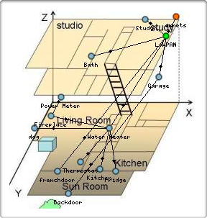
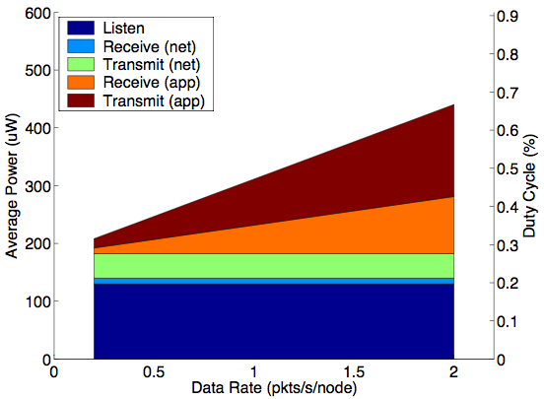
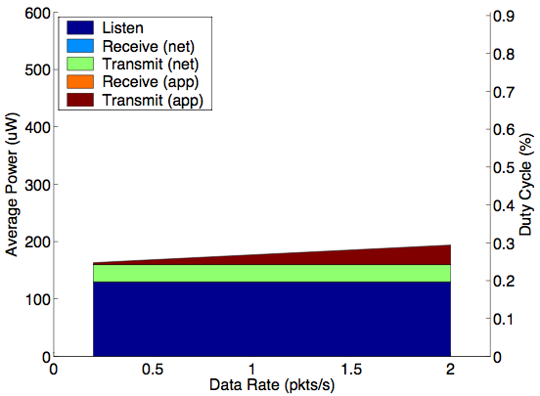
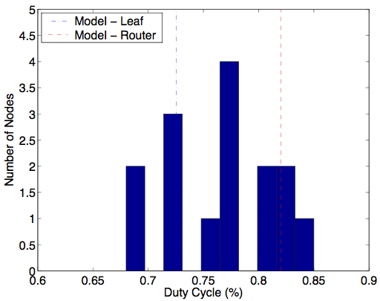
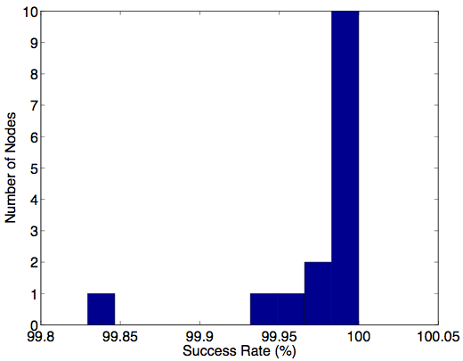
and Power and reliability …
Data Rate Sensitivity
(Router)
Data Rate Sensitivity
(Edge)
Deployment Duty Cycle
Deployment Reliability

Slide 12
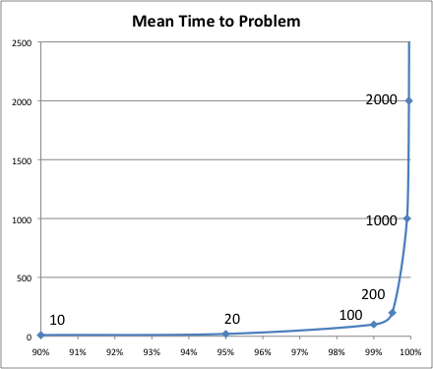
Time, Time, Time, …

Slide 13
and scale
Operating at scale and achieving reliability are fundamentally linked
Larger => More likely for problem to appear
Rarer => More subtle to find and understand
Larger => More difficult to repair and more costly to be down

Slide 14
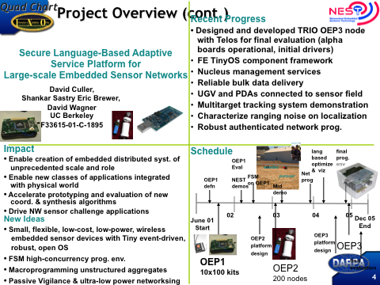
NEST Open Embedded Platform

Slide 15
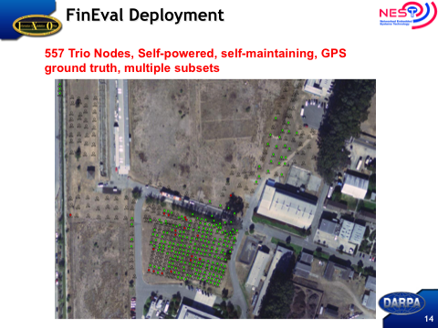

Slide 16
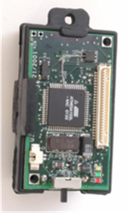
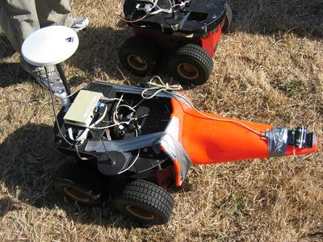
NEST Timeline
6/01 Start of NEST
1/02 Delivered 1000 Micas + TinyOS 0.6 kits to program projects
7/02 Bar Harbor Demos - Projects demo working components; OEP demos NEST-Tracker
2/03 San Diego Demo - OEP demos NEST-Tracker composable framework
  Collect services from projects
  SOCOMM and UW demos
7/03 PEG Demo - Mid-Term Demo on OEP2
  Show feasibility of platform and middleware
Projects build on OEP: Line in Sand, Shooter Localization, Perimeter
eXScale: combined effort on OEP2 variant
8/05 Final Evaluation incl. OEP3 release
  Sustained deployment and multiuse facility
  Self-powered, robust net prog, mgmt, dist alg and protocols
  Multi-object pursuit evasion game

Slide 17
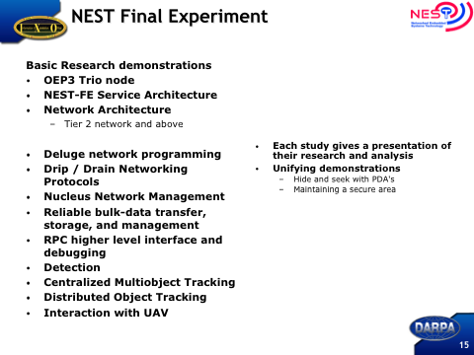
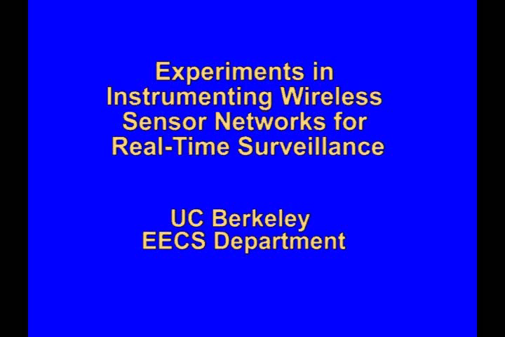

Slide 18
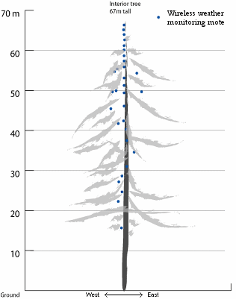
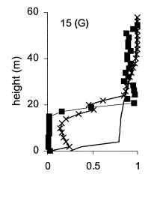
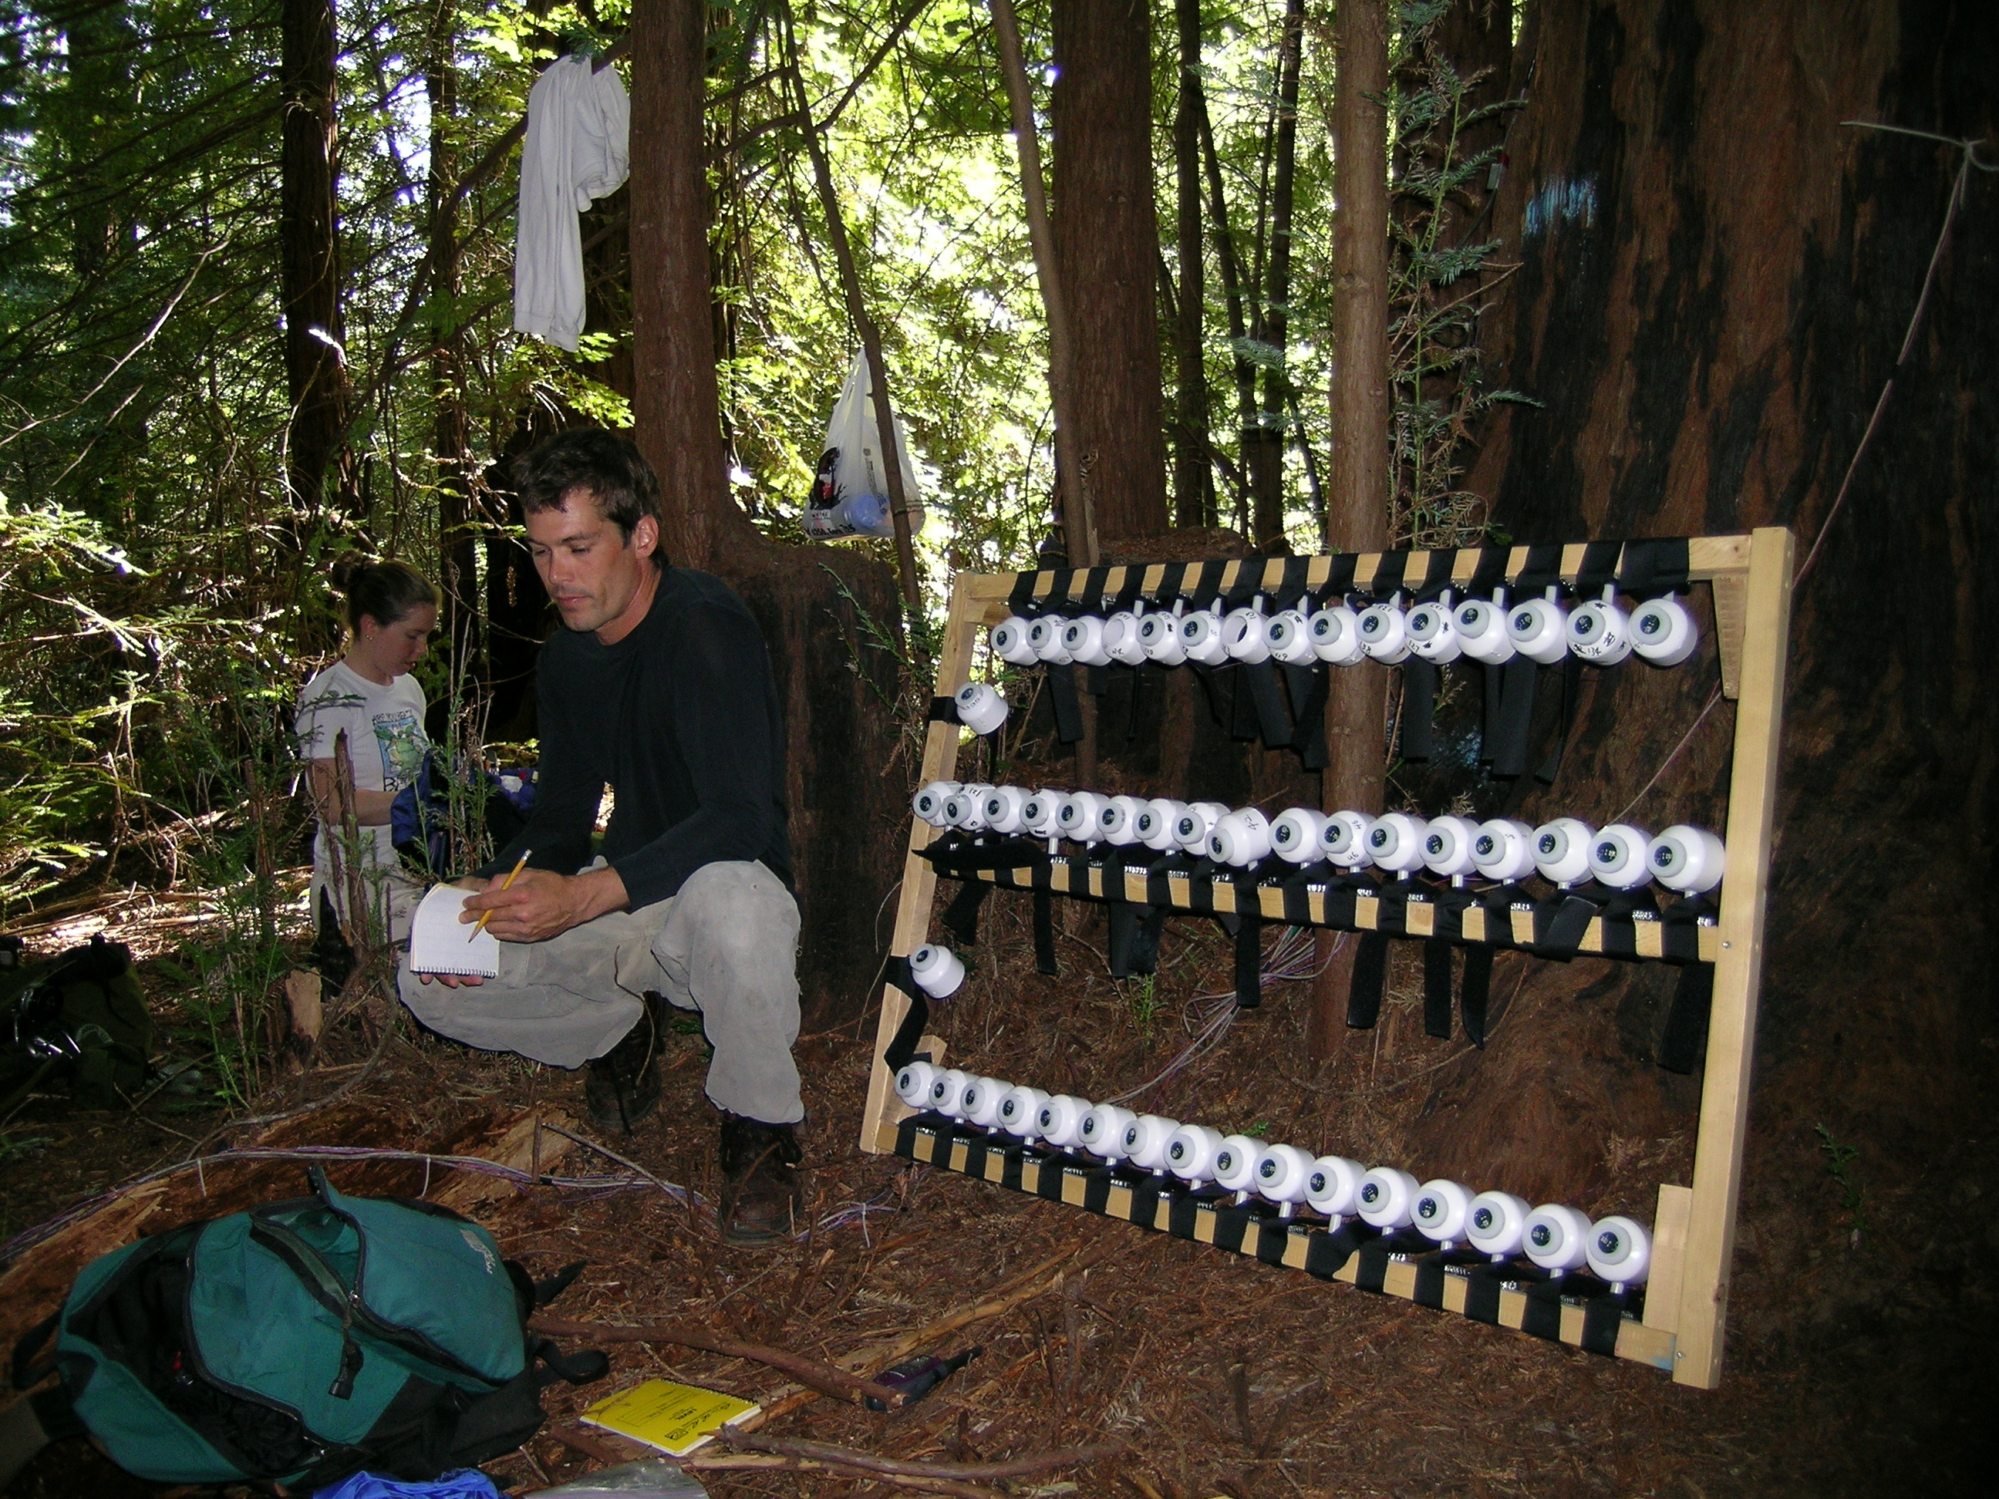
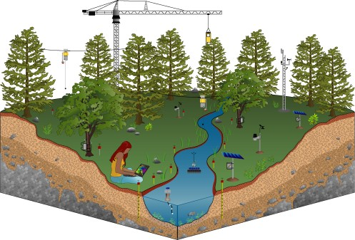
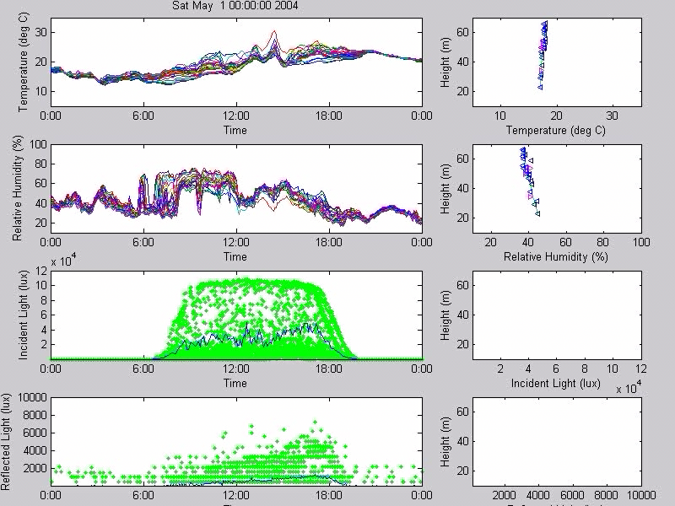
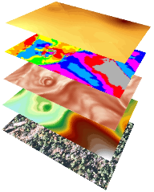
The “Macroscope”
Observe complex interactions over time and space
Slope (Spatial Analyst)
Aspect (Spatial Analyst)
Daily Average Temperature(Geostatistical Analyst)
Elevation (Calculated from Contour Map)
Aerial Photograph (10.16cm/pixels)

Slide 19
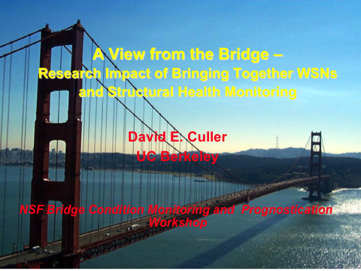

Slide 20
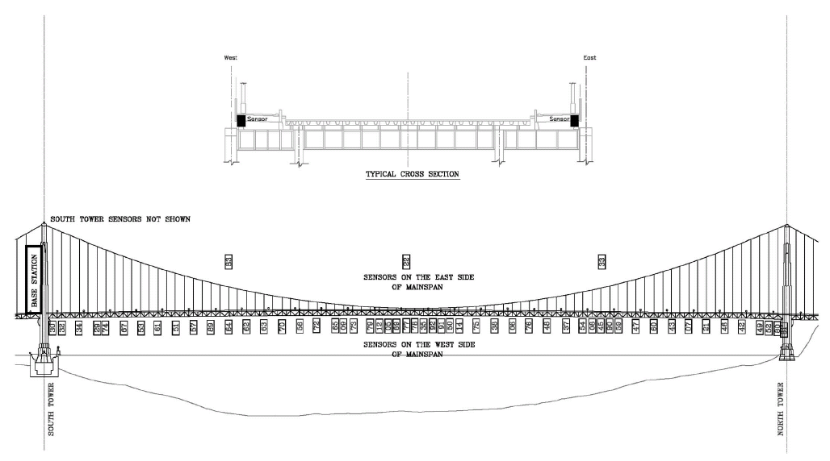
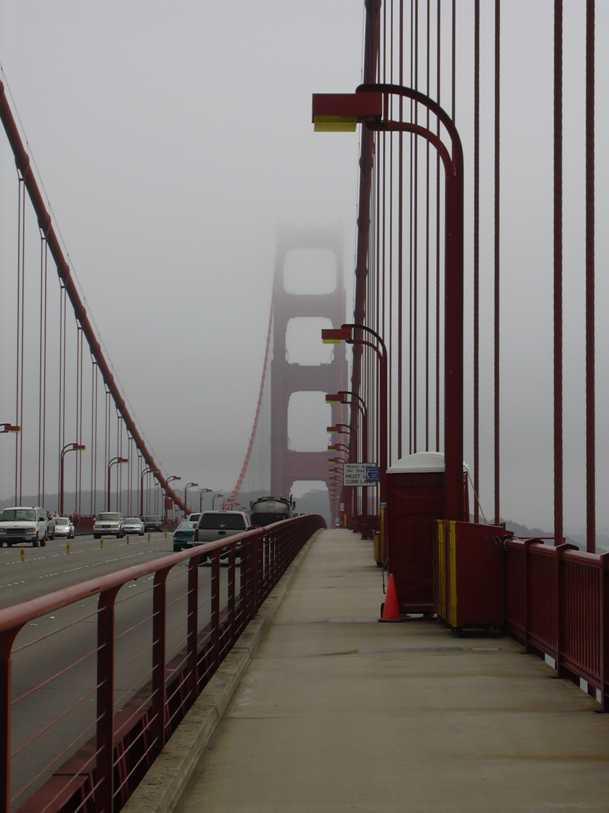
GGB: What Got Accomplished
SF
(south)
Sausalito
(north)
8 nodes
56 nodes @ 50-100 ft
43 hops
246 ft
1125 ft
4200 ft
High-Fidelity wireless 2D x 2 accelerometer node
  earthquake: ±2G @ 2 mG, ambient: ±0.1G @ 30 uG
High-frequency, low-jitter, time-synchronized sample-process-log
Large-scale monitoring network in the Real World
  Routing, command dissemination, time synch
Reliable bulk data transport on very deep network
Off-line Modal Analysis
2 PhDs – CS: Sukun Kim, CE: Shamim Pakzad

Slide 21
GGB: What didn’t?
Any deep epiphany on the design, maintenance, or modifications of the Golden Gate Bridge
Continuous, near real time, long term, high-fidelity, vibration analysis service
  On-going fatigue, wear-and-tear, alteration, traffic, …
  Intermittent critical events
    Earthquakes, Storms, … World Series, …
Not even close
But it is now a different world than in 2003…

Slide 22
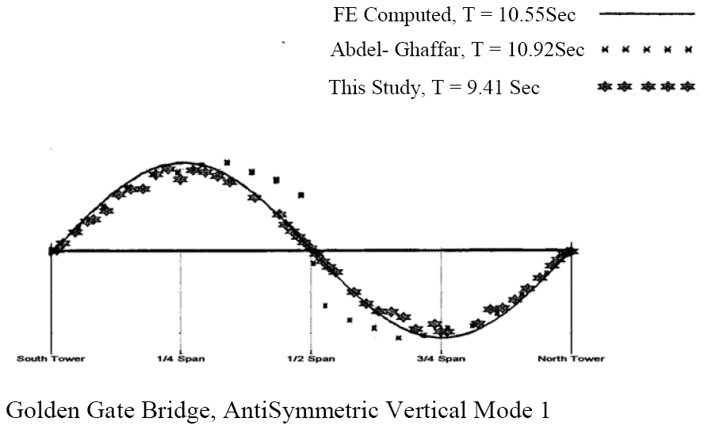
Bottom Line: Spatio-Temporal Analysis
First (and only?) large-scale, time-correlated, high-frequency wireless physical monitoring

Slide 23
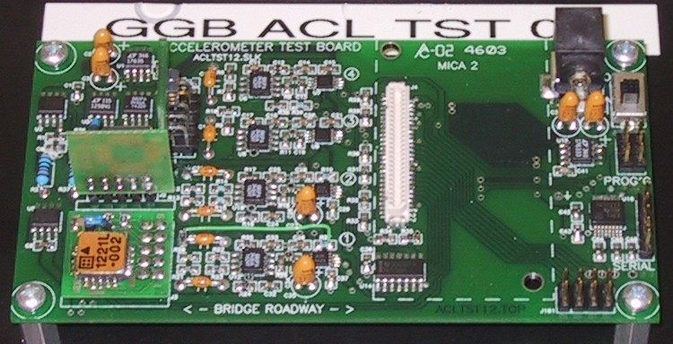
Holistic Error Analysis & Design
Quantization
Sampling
f _{range} * 2 ^{–(n-k)}
xx (μG/√Hz)
Coupling to the
Physical
Phenomenon
Over-sampling & Averaging
ADC
Conditioning
Sensor
Jitter
Calibration
Time Synch.
Lesson from Computational Science: “roughly equal contribution to the overall error”

Slide 24
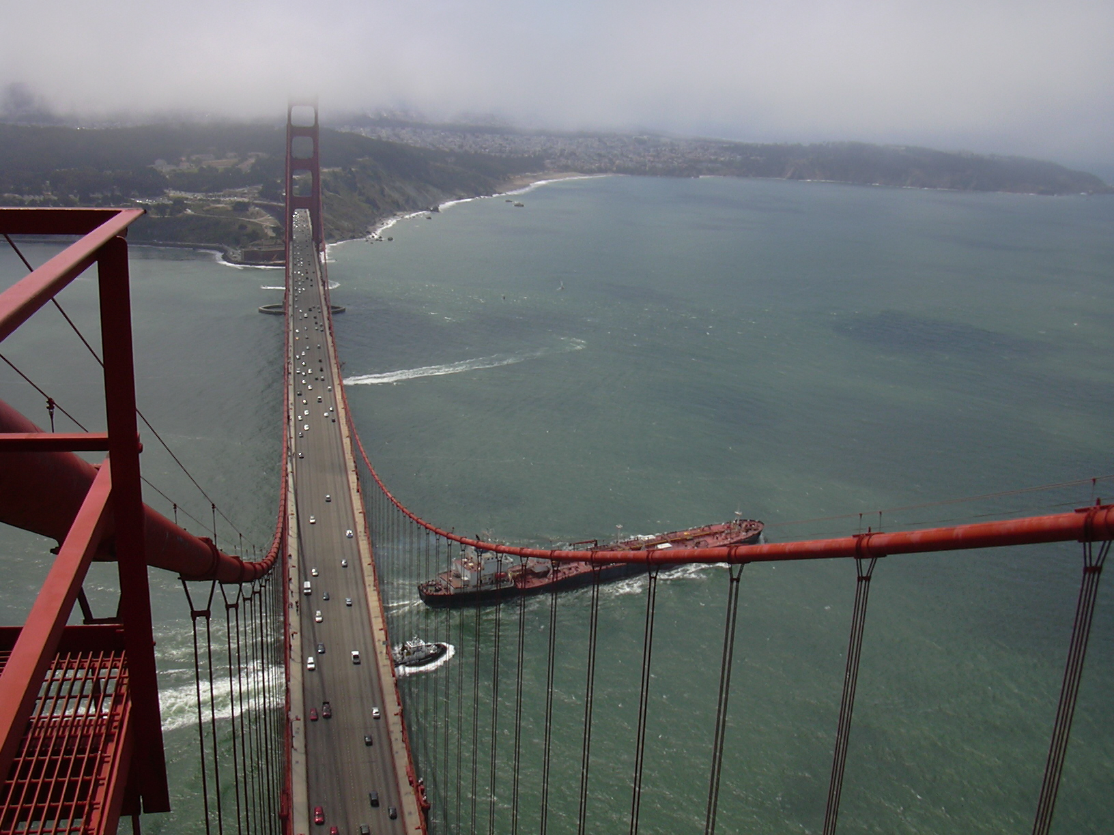
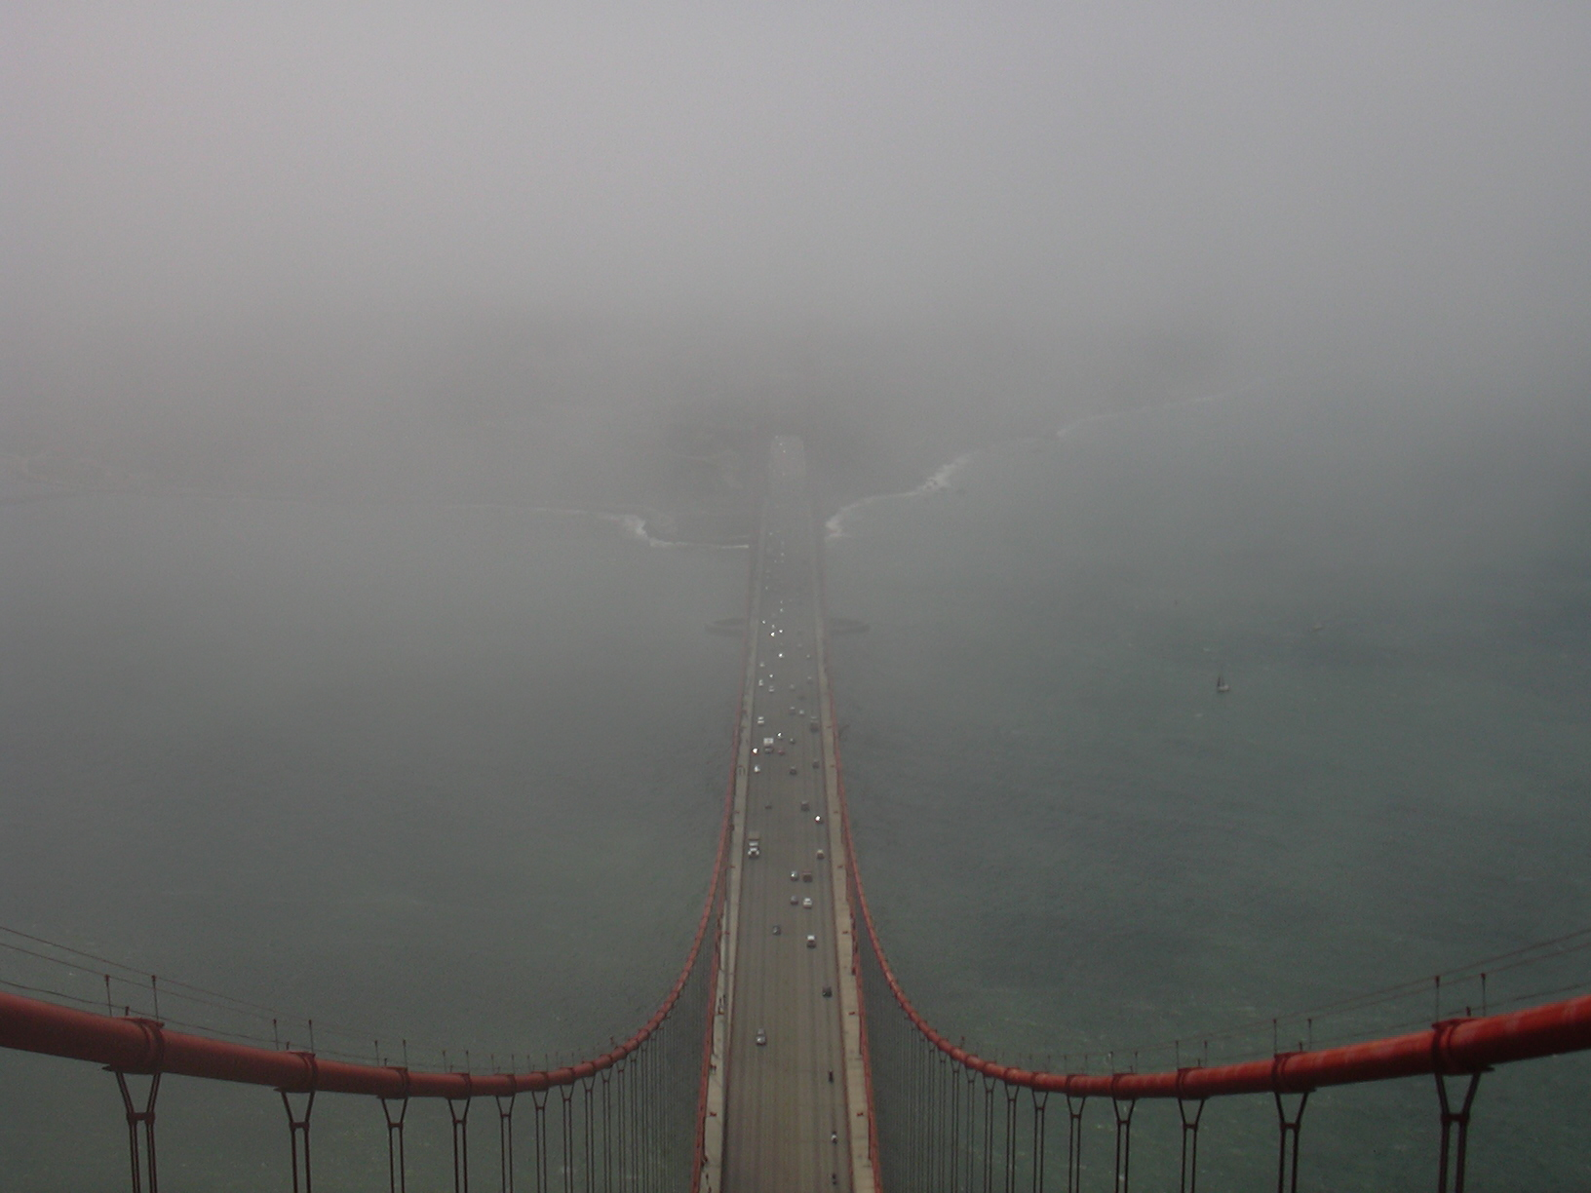
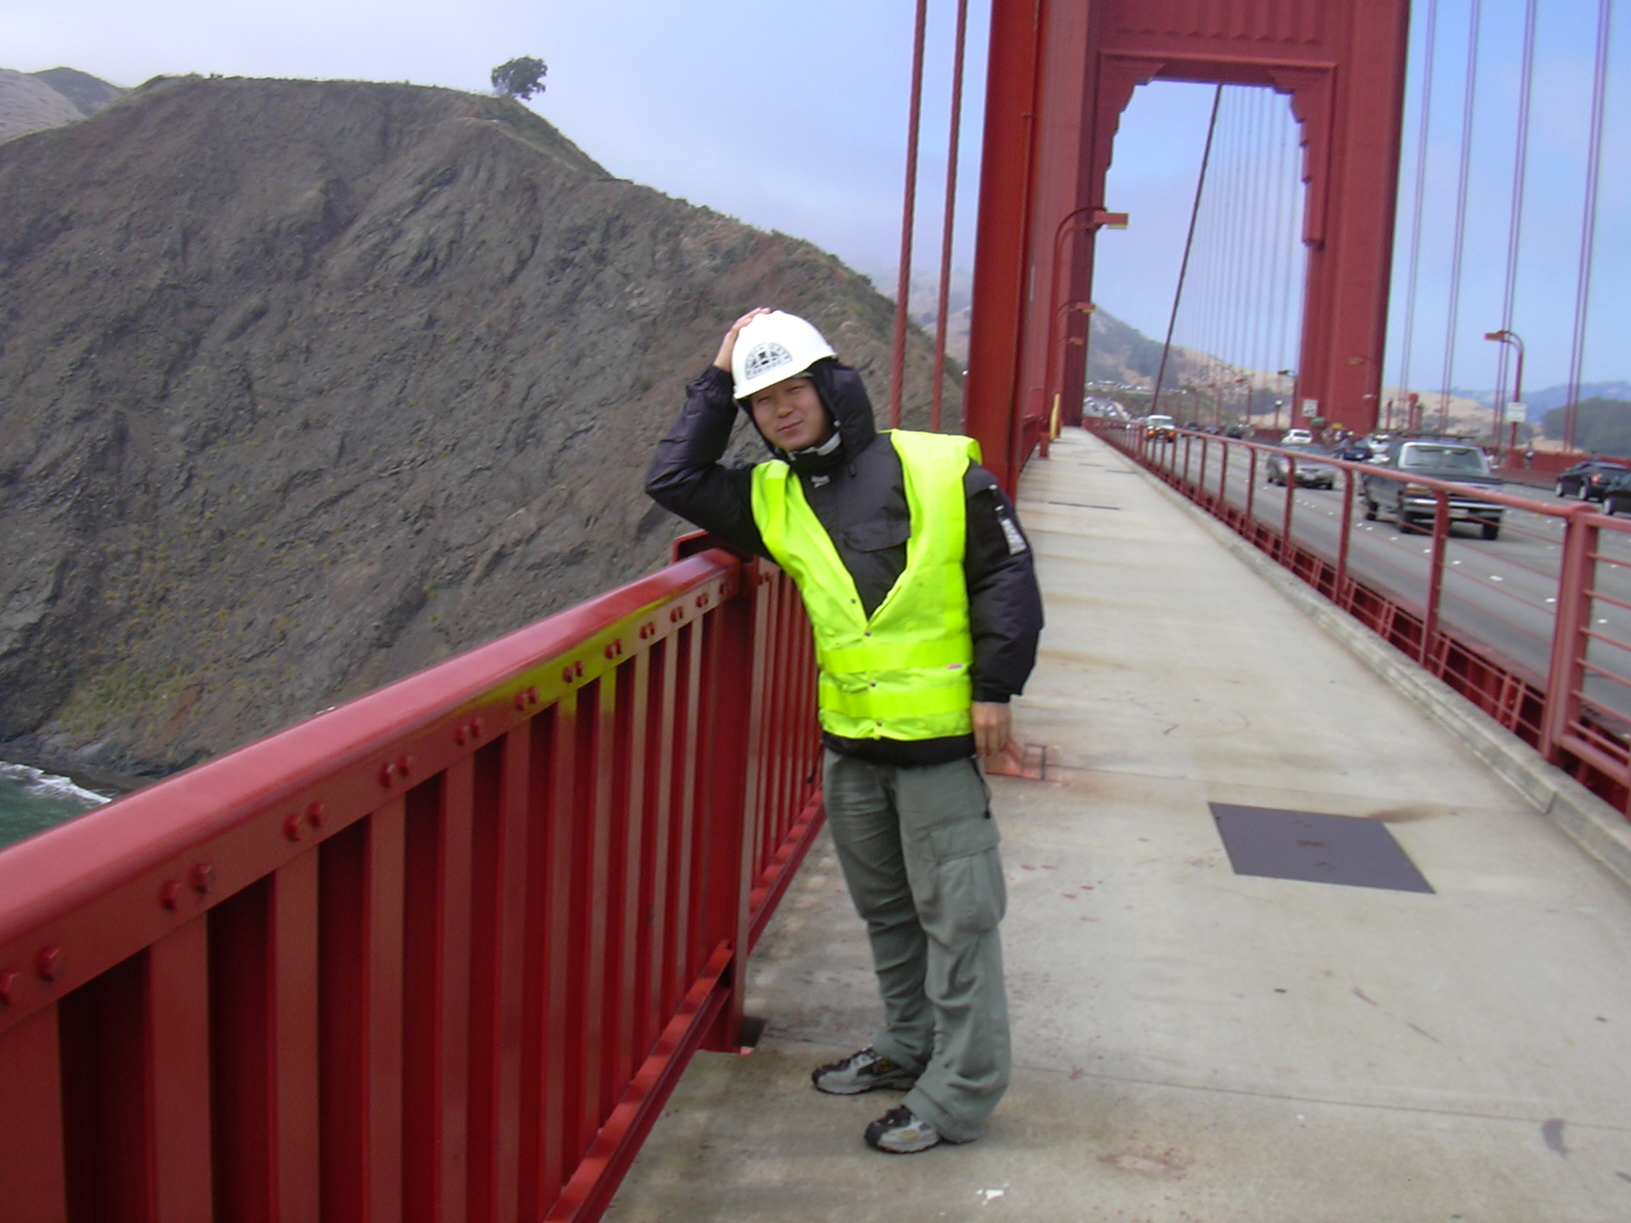
Environment
Fog
Strong and salty wind
Rapidly changing
... high and scary

Slide 25

Node – Physical Attachment
Battery (4 X 6V Lantern Battery)
Bi-directional
Patch Antenna
- long linear structure
Node (Mote + Accelerometer Board)
- bits of precision in orientation?

Slide 26

Node – Changing Physical Attachment
Zip-tie Antenna stay
- blowin the wind
Rapid Rusting of C-clamp

Slide 27


Base Station
Laptop
Students At Work

Slide 28



Installation
Crawling and Installing
Hard Hat
Done!
Strong Wind
Harness
However…
Ouch
Sharp Edge

Slide 29
Straw: Data Collection at GGB
Data is collected reliably over a 46-hop network, with a bandwidth of 441B/s at the 46th hop

Slide 30


Slide 31


Slide 32
Research at Scale …
Scaling how?
  # nodes, extent, fidelity, scientific accuracy, cost, reliability, duration, realism, …
Scaling why?
RaS is hard, time consuming, expensive, full of critical minutia, unappreciated, …
and incredibly important
when the time is right

Slide 33

“Fairytale” RaS

Slide 34






















Towards an “Aware” Energy Infrastructure
Baseline + Dispatchable Tiers
Oblivious Loads
Generation
Transmission
Distribution
Demand
Non-Dispatchable
Sources
Aware Interactive Loads
Communication
Communication

Slide 35
Start from Scratch?
No!

Slide 36





Grid Exists
Generation
Transmission
Distribution
Load
Conventional Electric Grid

Slide 37
Internet Exists
Generation
Transmission
Distribution
Load
Conventional Electric Grid
Conventional Internet

Slide 38



Intelligent Energy Network as Overlay on Both
Intelligent Energy Network
Source IPS
energy subnet
Load IPS
Intelligent Power Switch
Generation
Transmission
Distribution
Load
Conventional Electric Grid
Conventional Internet

Slide 39


Living Laboratories
Environmental
Operational

Slide 40













Energy Transparent Building
DOP HVAC
MCL equip
Whole Bldg
MCL infra
Central vent
office HVAC
MCL vac
inst Lab 199
HVAC
servers
Lighting
Plug loads
Parking Lot

Slide 41



Mother nature …

Slide 42
Research at Scale …
Scaling how?
  # nodes, extent, fidelity, scientific accuracy, cost, reliability, duration, realism, …
Scaling why?
Need to approach RaS fundamentally differently than traditional lab/simulation style academic research

